Slide 1

Name: Patel Pratham ID :20IT105 Course : Software Group Project
IOT Streetlight Controller System

Slide 2

What I want to do?
In this I want to develop automatic street light monitoring and controlling system.
In that street light intensity gets Changed along with the environment.

Slide 3
How it works?
If you walk at night the light intensity will be high and in the morning falls to the minimum
This data is monetarized by online system in that it showing the unit consumes

Slide 4
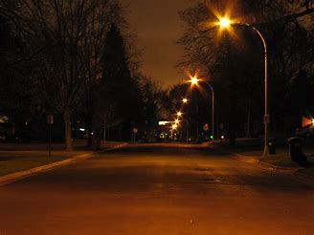
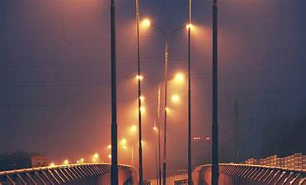
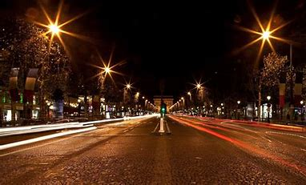
How it works?

Slide 5


Features of it
Stop the wastage of electricity .
Provide the safe environment.

Slide 6
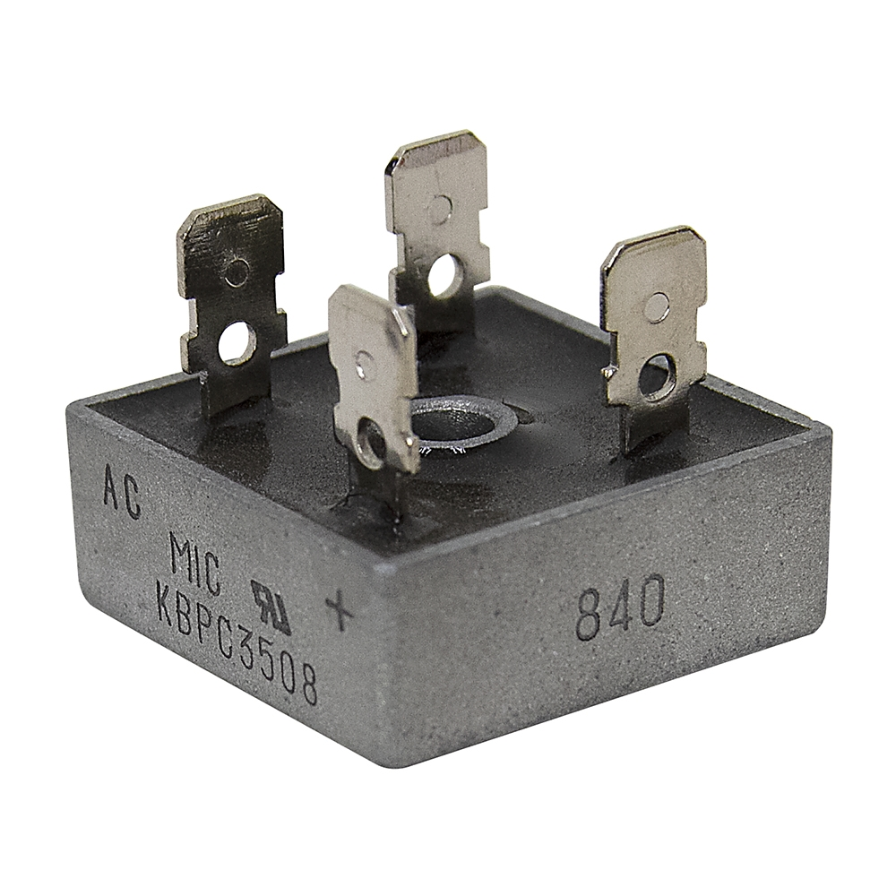
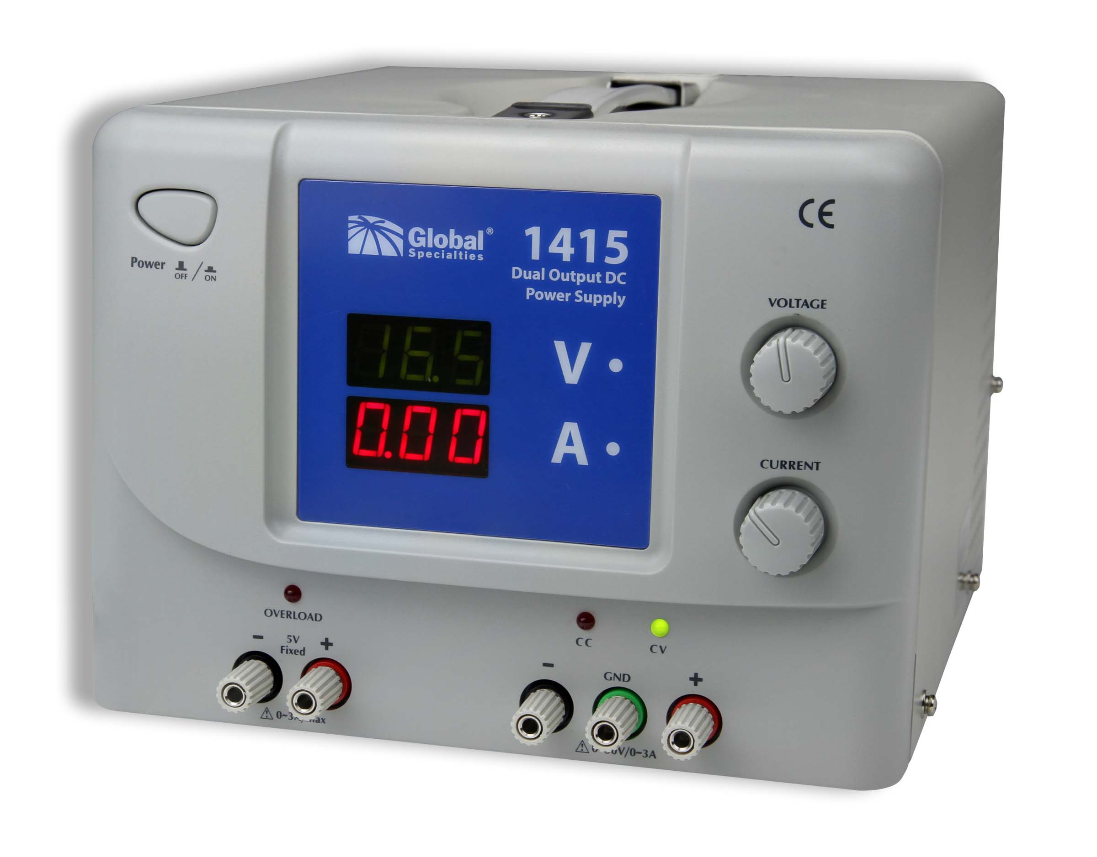
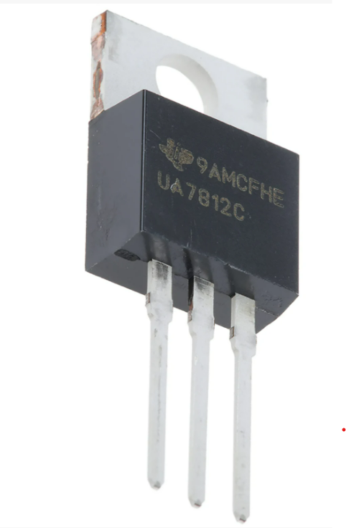
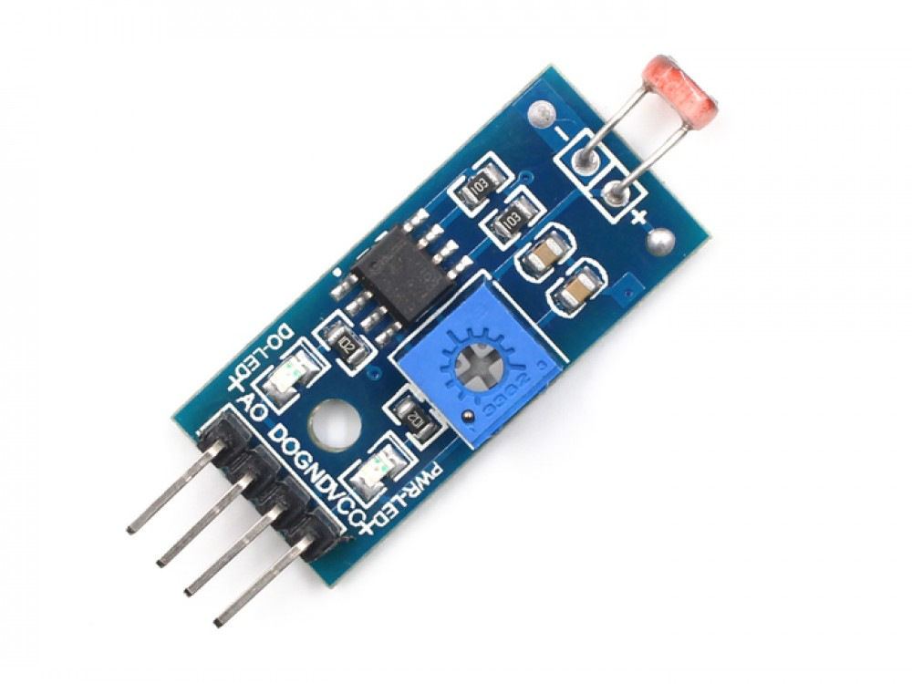
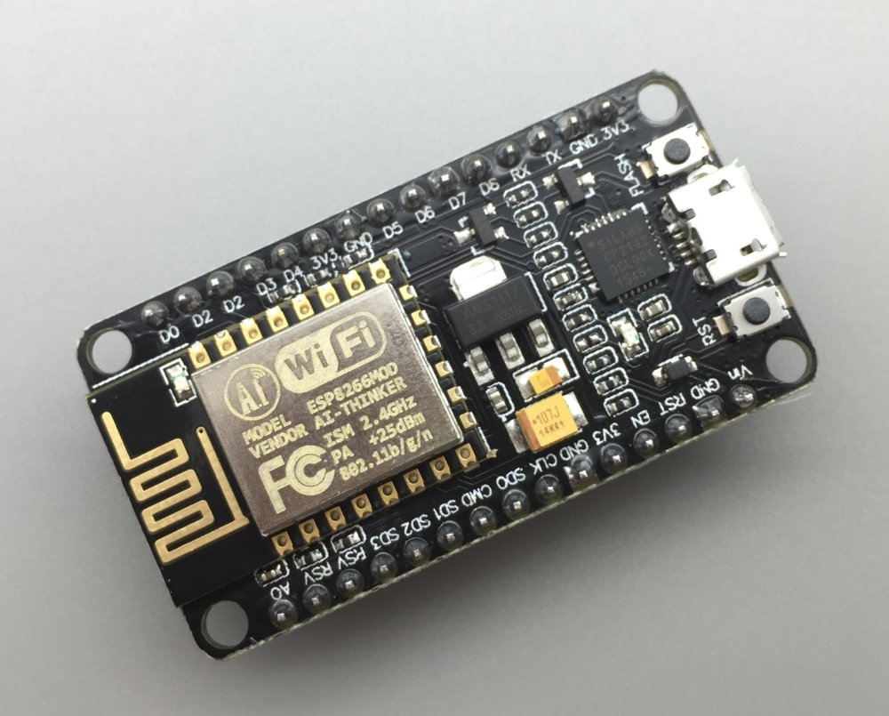
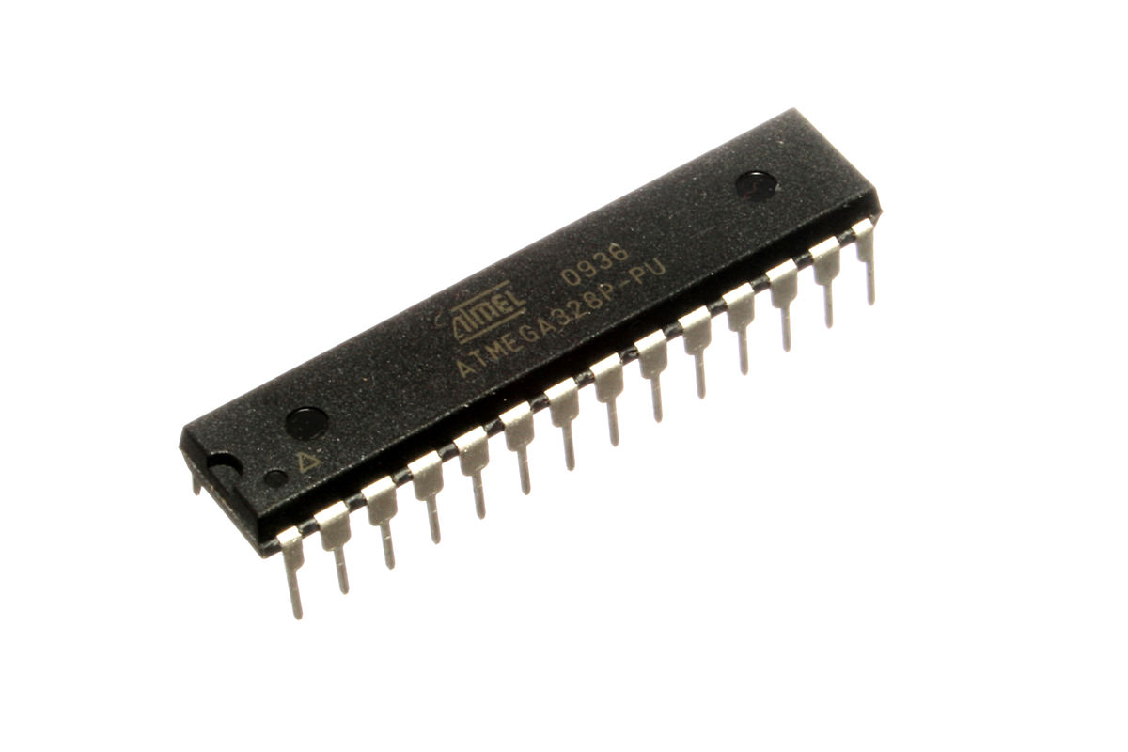
Hardware that used in it.
Rectifier
Regulator
Power Supply
Light Sensor
Wifi Module
Atmega 328

Slide 7
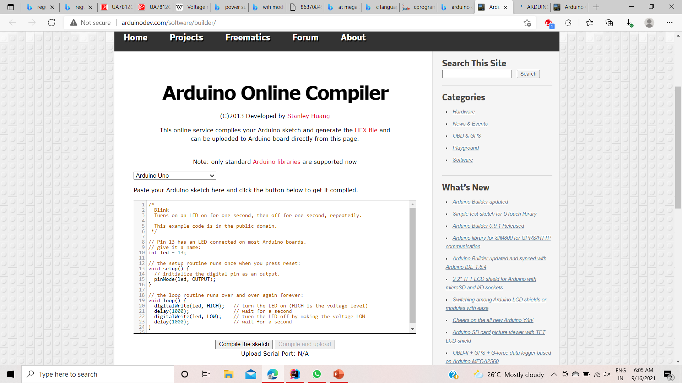

Software that used in it.
Programming Language : C
Arduino Online Compiler

Slide 8
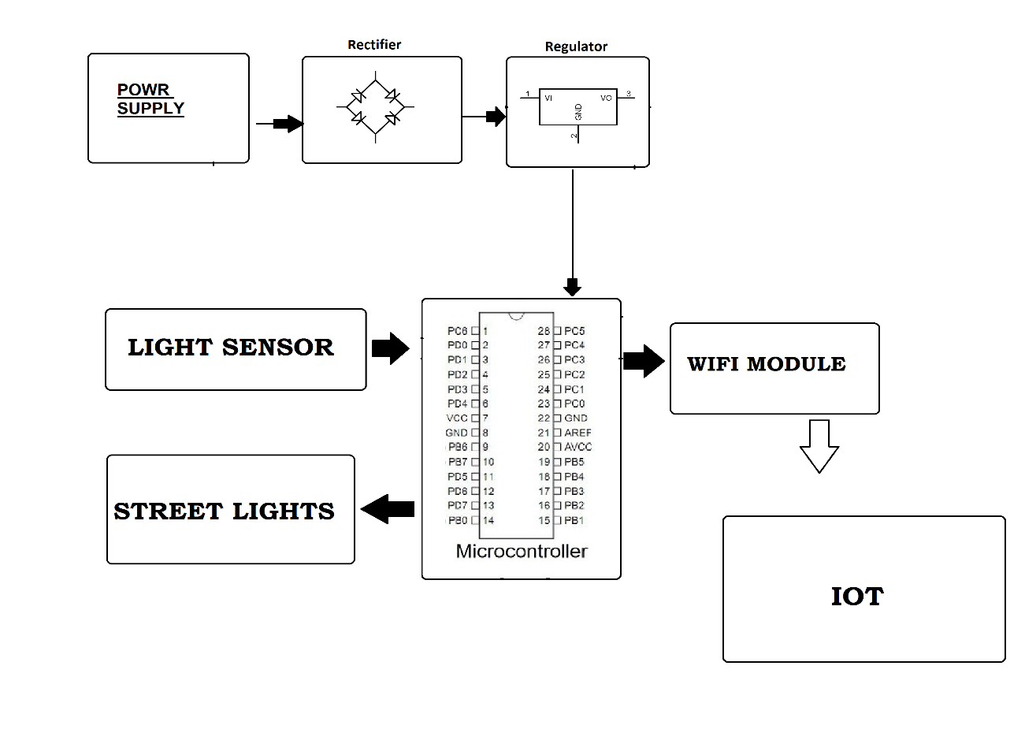
Block Diagram:

Slide 9
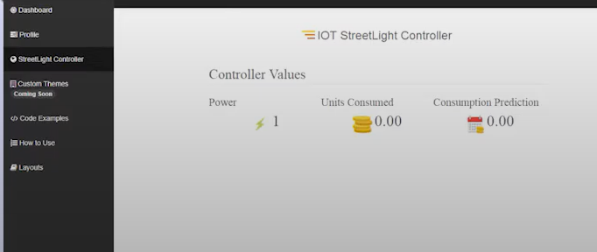
How online system look like?

Slide 10
Demo Model used Components
LDR
100K PRESET
BT 136 TRIAC
BC547 TRANSISTOR
220 OHMS RESISTOR * 2

Slide 11
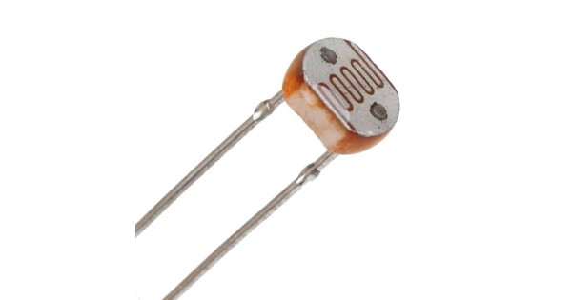
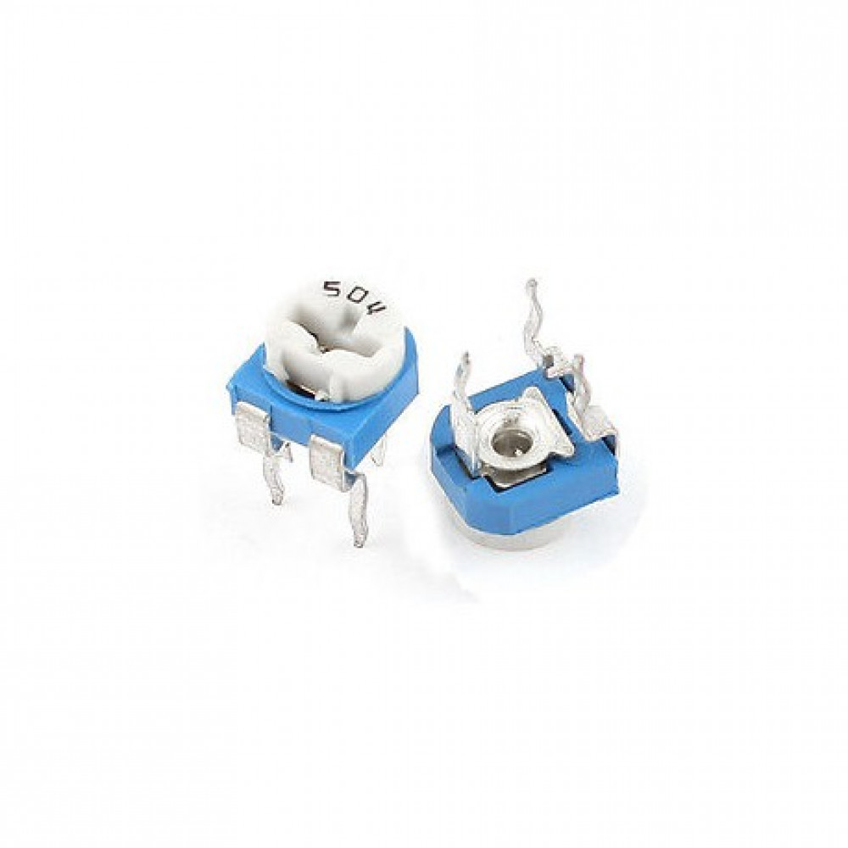
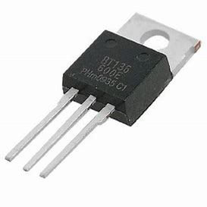
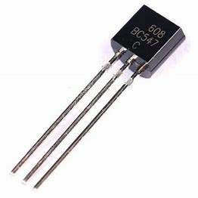
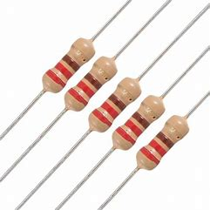
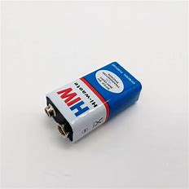
CONTINUE….

Slide 12
Hardware components explanation
LDR : An LDR is a type of variable resistor which changes its resistance according to the intensity of the light falling on its surface.
100K PRESET : Preset 100K Ω (ohm) (Variable Resistance) This adjustable or Variable resistor are PCB mountable and has 3 terminals. The voltagle between the terminal varies as the preset is rotated.
BT 136 TRIAC : The BT136 is TRIAC with 4A maximum terminal current. The gate threshold voltage of the BT136 is also very less so can be driven by digital circuits. Since TRIACs are bi-directional switching devices they are commonly used for switching AC applications.

Slide 13
CONTINUE….
BC 547 TRANSISTOR : BC547 is a NPN transistor hence the collector and emitter will be left open (Reverse biased) when the base pin is held at ground and will be closed (Forward biased) when a signal is provided to base pin.
220 OHMS RESISTOR *2 : 220 ohm ¼ watt Resistor (Pack of 10) A resistor is a passive two-terminal electrical component that implements electrical resistance as a circuit element. Resistors act to reduce current flow, and, at the same time, act to lower voltage levels within circuits.

Slide 14
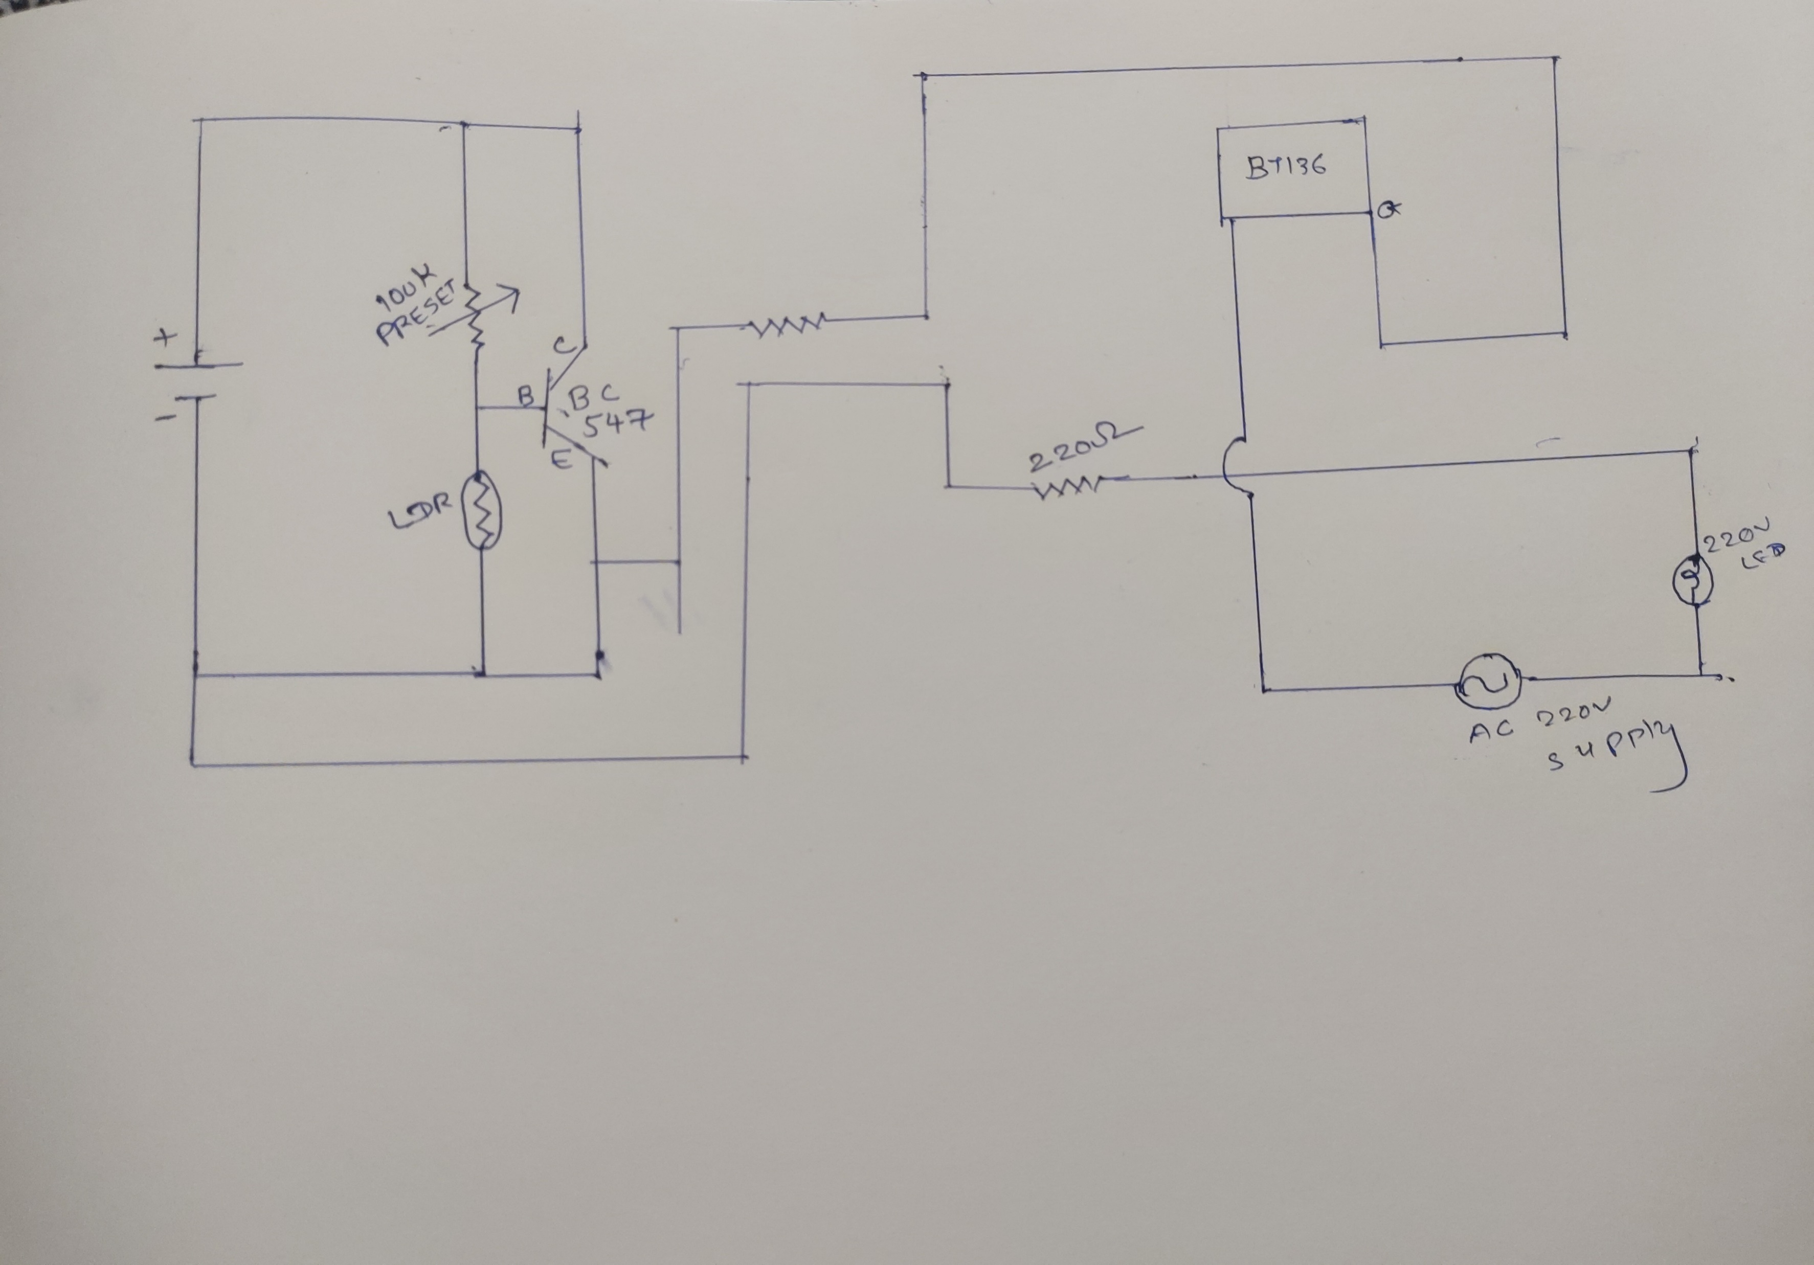
Diagram:

Slide 15
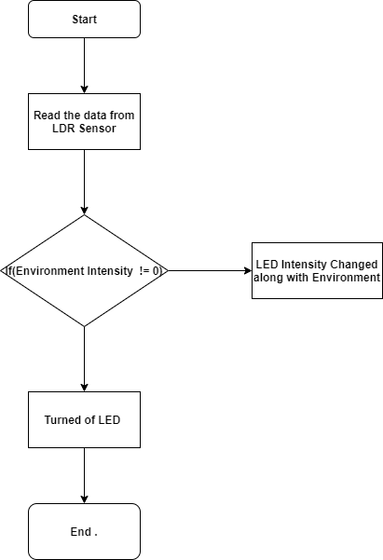
Flow -chart

Slide 16
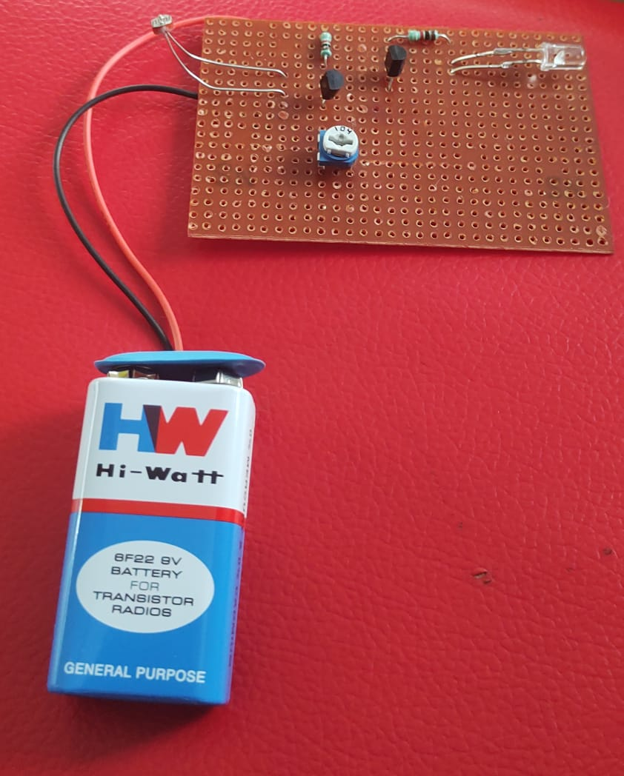
Demo Project :

Slide 17
My social media
Linked in : (8) Pratham Patel | LinkedIn
Github : 20IT105 (github.com)

Slide 18
Thank You

